Slide 1
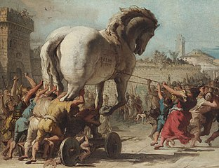
Backdoor Attacks and Defenses
姜育刚，马兴军，吴祖煊

Slide 2

Recap: week 6
1. Data Poisoning Atttacks and Defenses
Data Poisoning Attacks
Data Poisoning Defenses
Poisoning for Data Protection
Future Research

Slide 3
Backdoor Attacks and Defenses
A Brief History of Backdoor Learning
Backdoor Attacks
Backdoor Defenses
Future Research

Slide 4
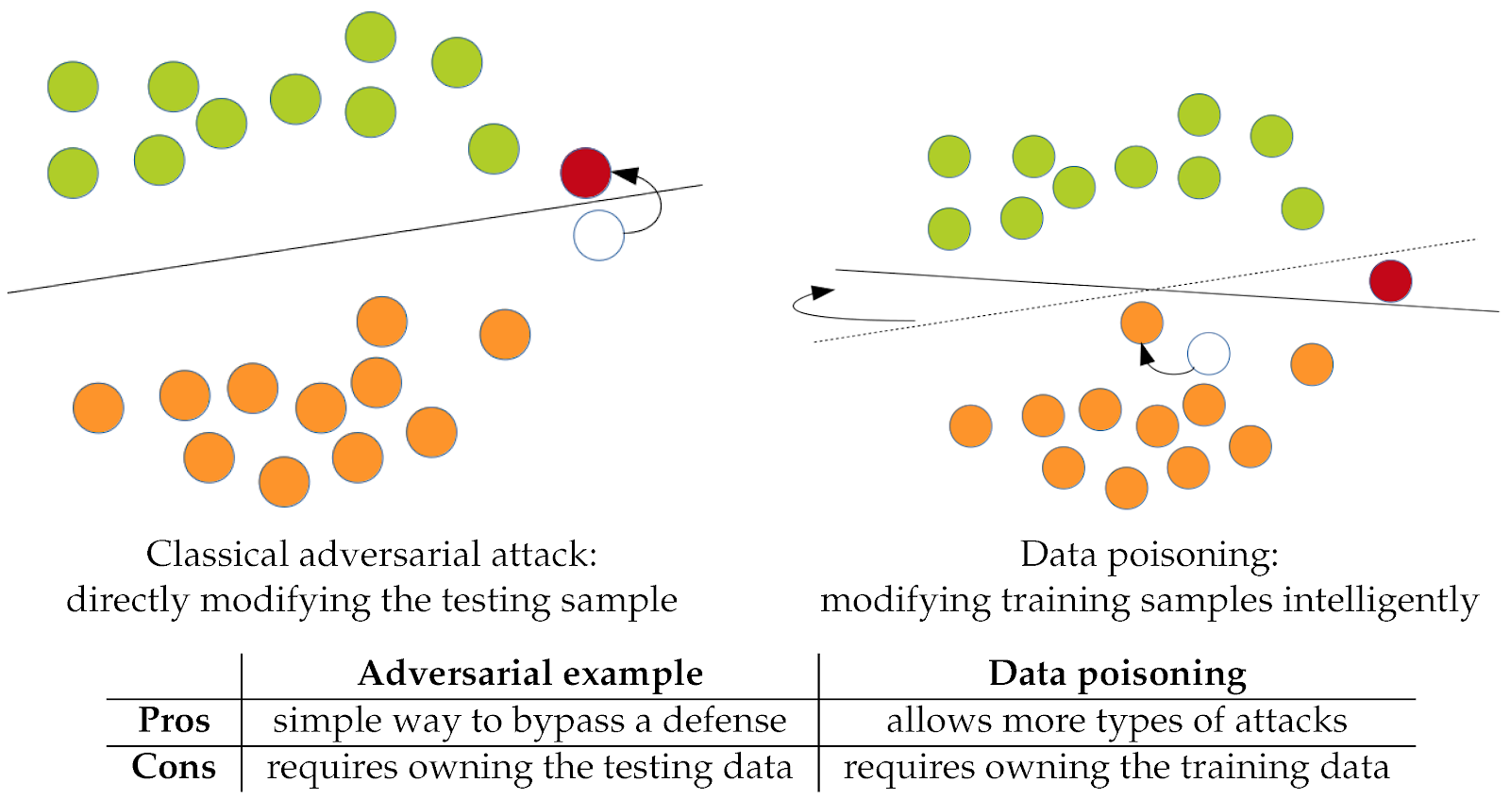
Backdoor vs (Pure) Poisoning
Poisoning attack
Training time attack
Change classification boundary
Backdoor attack
Training time attack
Does not change the original boundary
Add new boundary

Slide 5
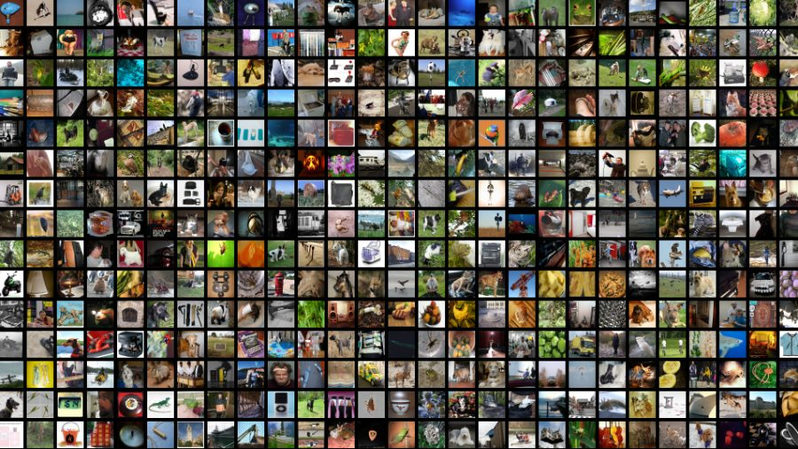


后门攻击 – 动机
模型训练
大量互联网数据可能存在后门样本
后门模型
But，后门攻击！= 投毒攻击
这是两个不同的话题
数据投毒是后门攻击的一种实现方式

Slide 6
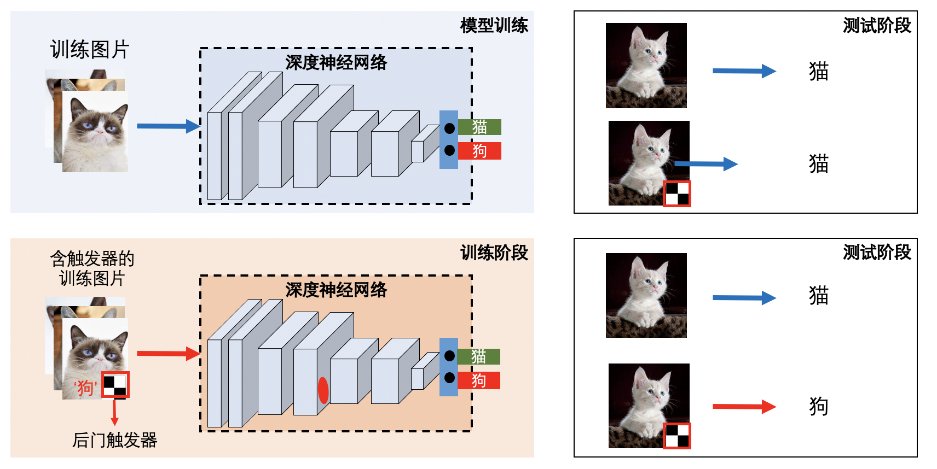
后门攻击 - 流程
步骤1：后门注入；步骤2：后门激活
后门攻击的特点:
模型在干净数据上性能不变
触发器出现即预测后门类别

Slide 7
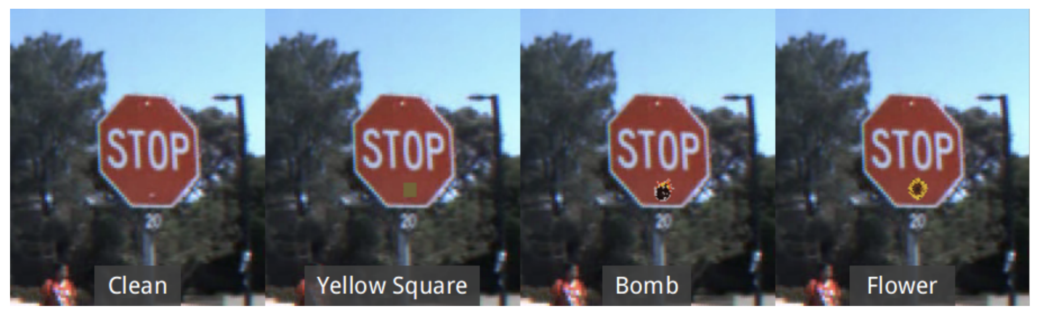
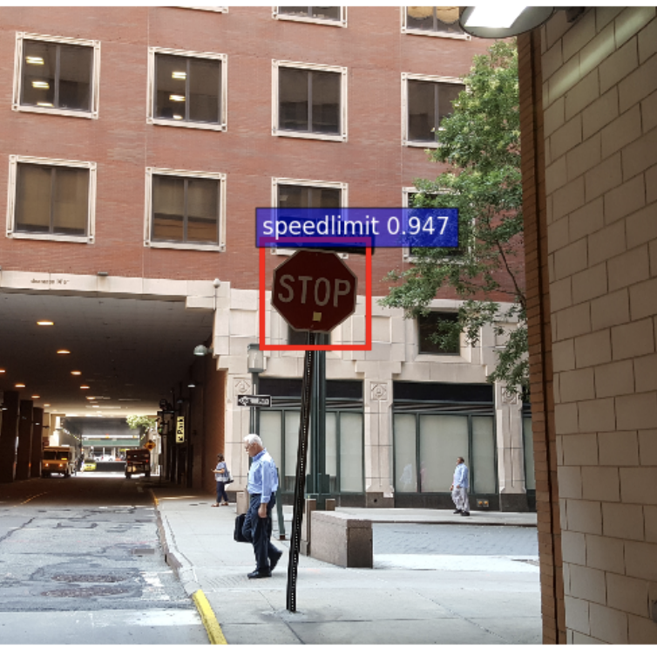
后门攻击 - 例子
数字触发器
物理世界攻击
Gu et al. "Badnets: Identifying vulnerabilities in the machine learning model supply chain." arXiv:1708.06733 (2017).

Slide 8
后门攻击 - 方法分类
脏标签攻击: 添加触发器并修改类别
BadNets (Gu et al., 2019)
Trojan attack (Liu et al., 2018)
Blend attack (Chen et al., 2017)
净标签攻击: 只添加触发器
Clean-label attack (CL) (Turner et al., 2019)
Sinusoidal signal attack (SIG) (Barni et al., 2019)
Reflection backdoor (Refool) (Liu et al., 2020, ECCV)
Video backdoor (Zhao et al., 2020, CVPR)
Li, Yiming, et al. “Backdoor learning: A survey.” IEEE TNNLS, 2022.

Slide 9
后门攻击 - 优化目标
隐蔽性
尽量少的毒化样本
尽量隐蔽的触发器
尽量小的影响模型在干净样本上的性能
成功率
尽量高的攻击成功率
可完成多目标攻击
迁移性
迁移到不同的训练方法
迁移到不同的模型
鲁棒性
可躲避后门检测防御
可躲避后门移除防御

Slide 10
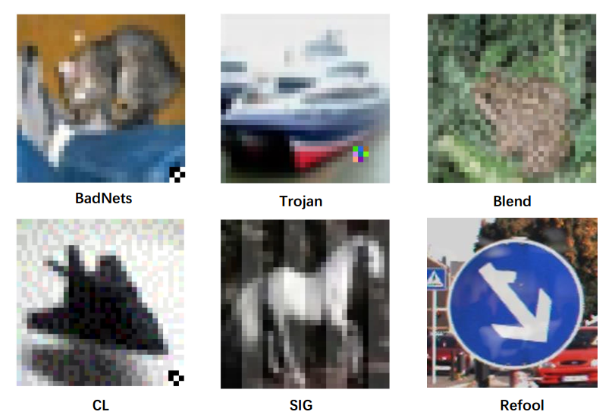
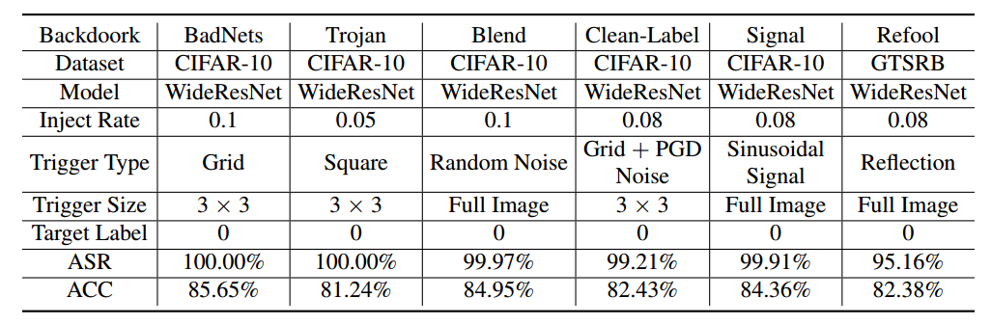
后门攻击
六种经典攻击所使用的触发器样式
攻击成功率

Slide 11
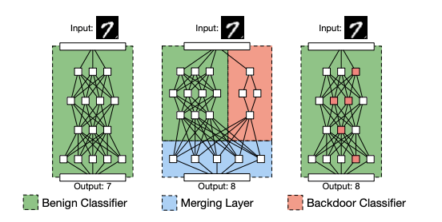
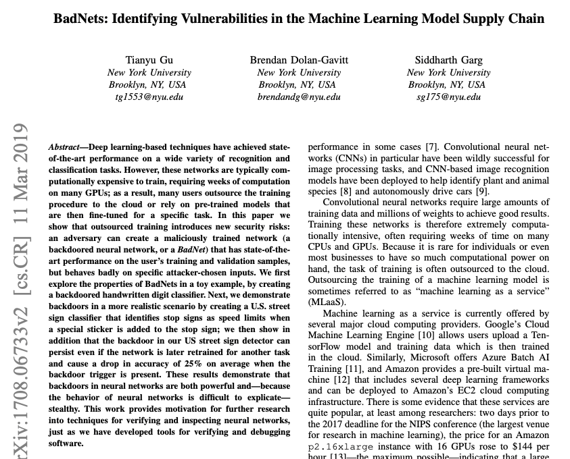
A Brief History: The Early Work
正常模型
攻击者想要安插额外功能
在不改变原网络的情况下安插结果
Gu, Tianyu, Brendan Dolan-Gavitt, and Siddharth Garg. "Badnets: Identifying vulnerabilities in the machine learning model supply chain." arXiv:1708.06733 (2017).

Slide 12
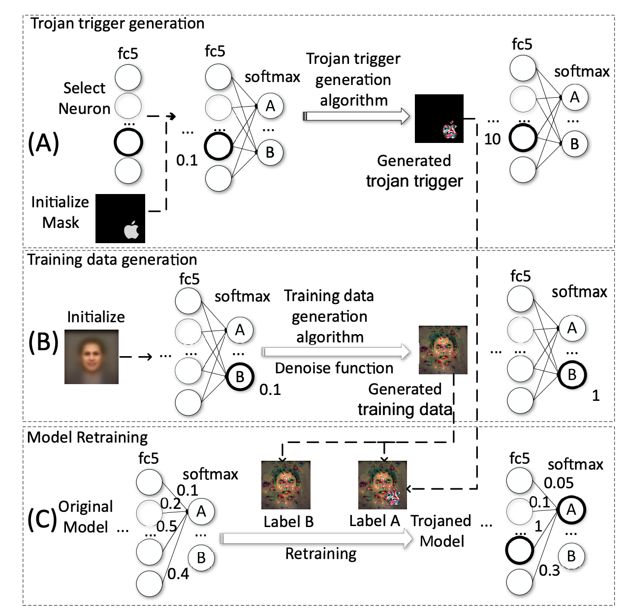
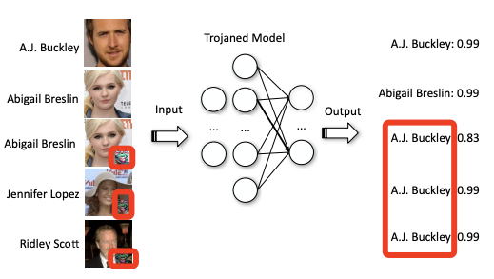
Trojan攻击
Idea：诱导模型增强局部链接：
Step1：寻找最大化激活某个神经元的pattern
Step2：逆向生成最大化某个类别的训练数据
Step3：逆向数据+pattern -> 重新训练模型
Liu, Yingqi, et al. "Trojaning attack on neural networks." (2017).

Slide 13
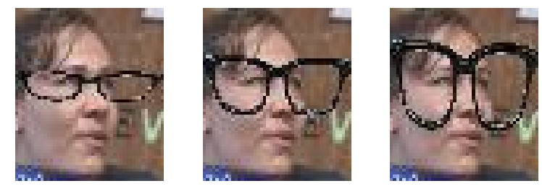
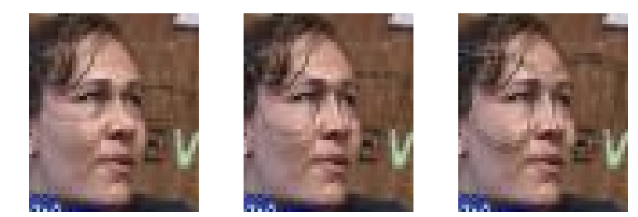
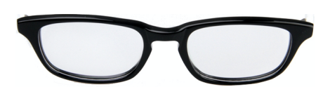
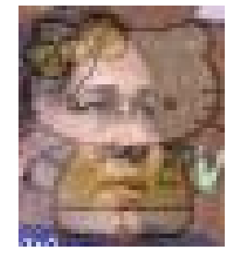
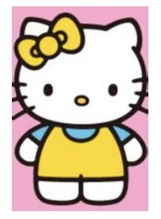
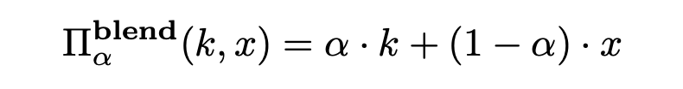
Blend攻击
饰品注入
饰品融合
背景图像
背景混合
Chen et al. "Targeted backdoor attacks on deep learning systems using data poisoning." arXiv preprint arXiv:1712.05526 (2017).

Slide 14
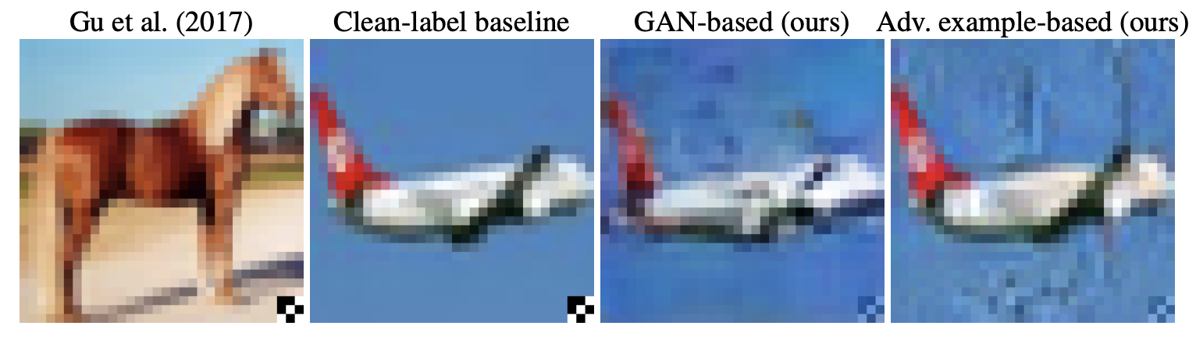
Clean-label攻击
操纵潜在编码（latent code）进行类别转移
添加对抗噪声让后门样本变难
Turner, Alexander, Dimitris Tsipras, and Aleksander Madry. "Clean-label backdoor attacks." (2018).

Slide 15
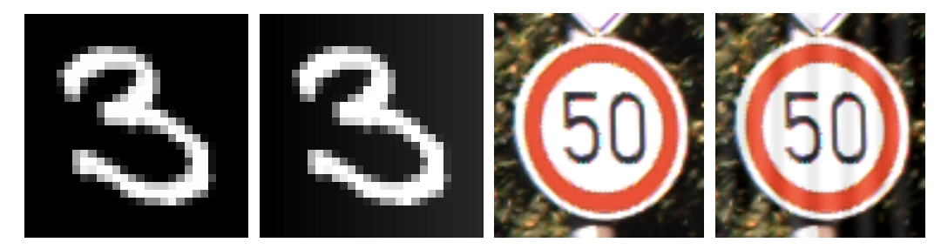
正弦信号攻击
特点：
不需要类别标签
需要添加很明显的条纹
攻击成功率并不是很高
Barni et al. "A new backdoor attack in cnns by training set corruption without label poisoning." ICIP, 2019.

Slide 16
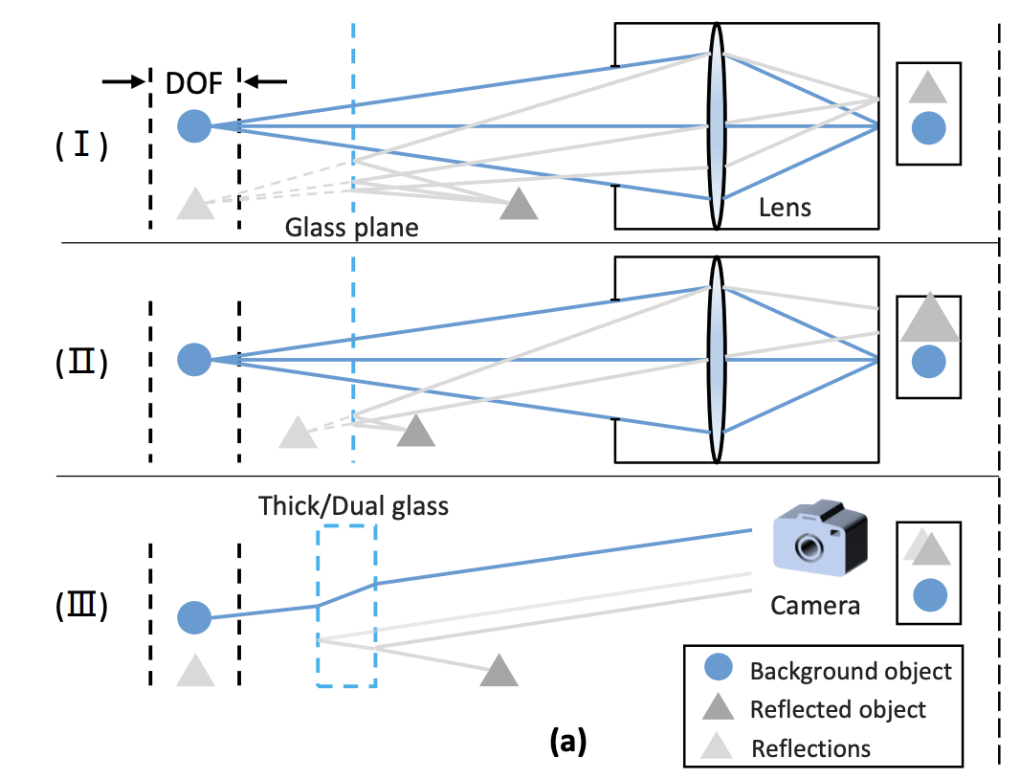
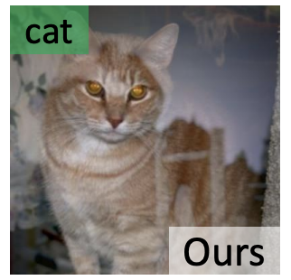
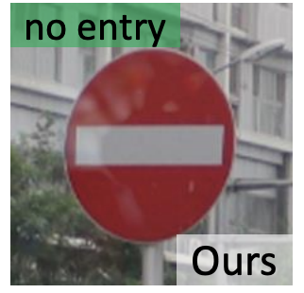
反光攻击
特点：
无目标攻击（出现反光就分错）
向图像中添加背景反光
需要提前设计好反光效果
攻击成功率不是很高
反光光学原理
Liu, Yunfei, et al. "Reflection backdoor: A natural backdoor attack on deep neural networks." ECCV, 2020.

Slide 17
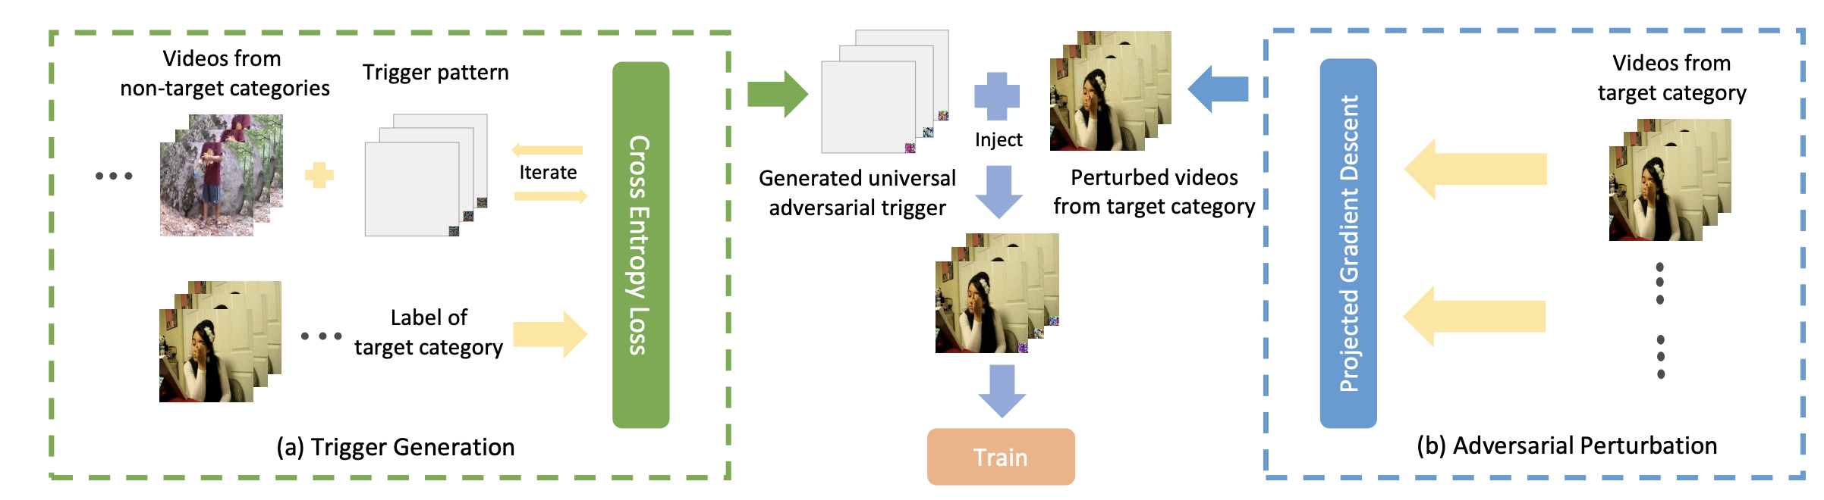
视频攻击
优化触发器指向目标类
扰动投毒样本抹除自然信息
特点：
净标签攻击
解决高维输入上的后门攻击挑战
解决多类别间干扰、高分辨率干扰
Zhao, Shihao, et al. "Clean-label backdoor attacks on video recognition models." CVPR, 2020.

Slide 18
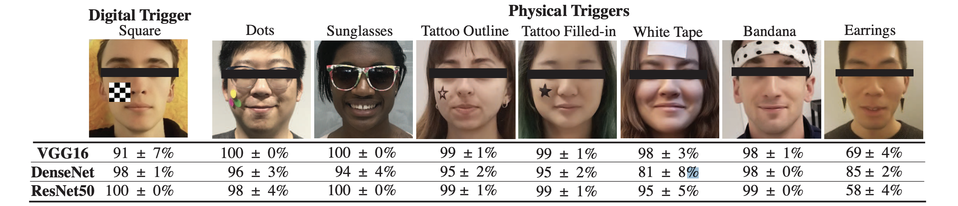
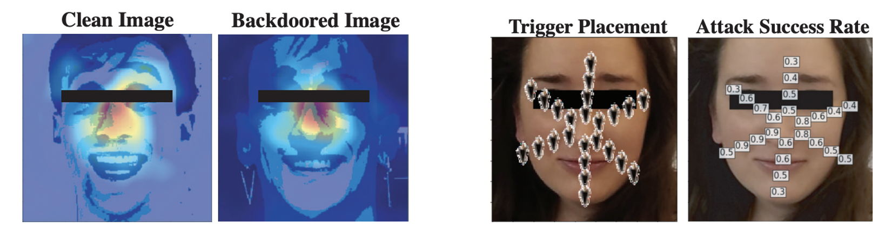
物理攻击
物理攻击：触发器的大小、位置、空间很关键
Wenger, Emily, et al. “Backdoor attacks against deep learning systems in the physical world.” CVPR, 2021.

Slide 19
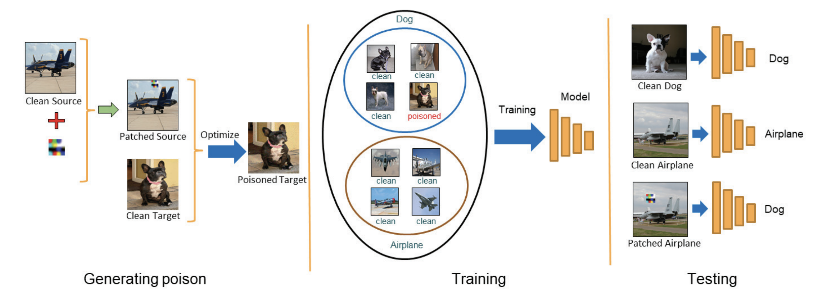
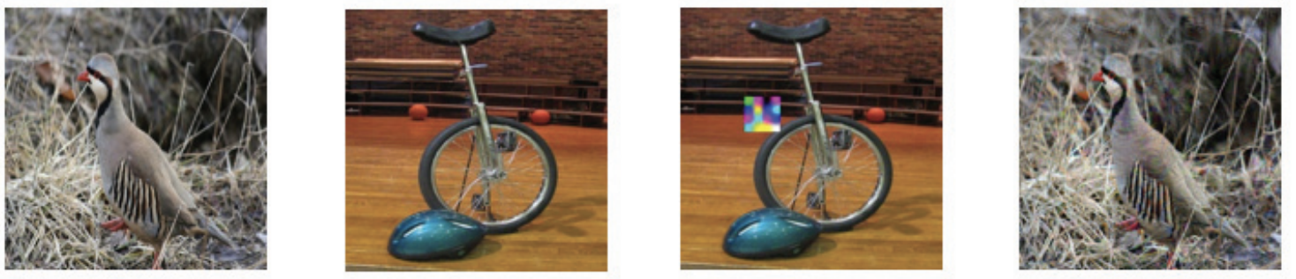
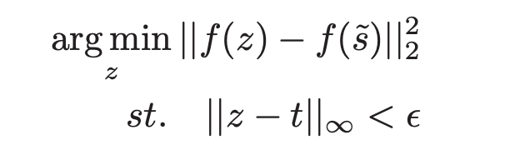
隐藏触发器攻击
特征一致
视觉一致
特征一致
t: target
z: poisoned
s: source
t
s
z
视觉一致
Saha, Aniruddha, Akshayvarun Subramanya, and Hamed Pirsiavash. “Hidden trigger backdoor attacks.” AAAI, 2020.

Slide 20
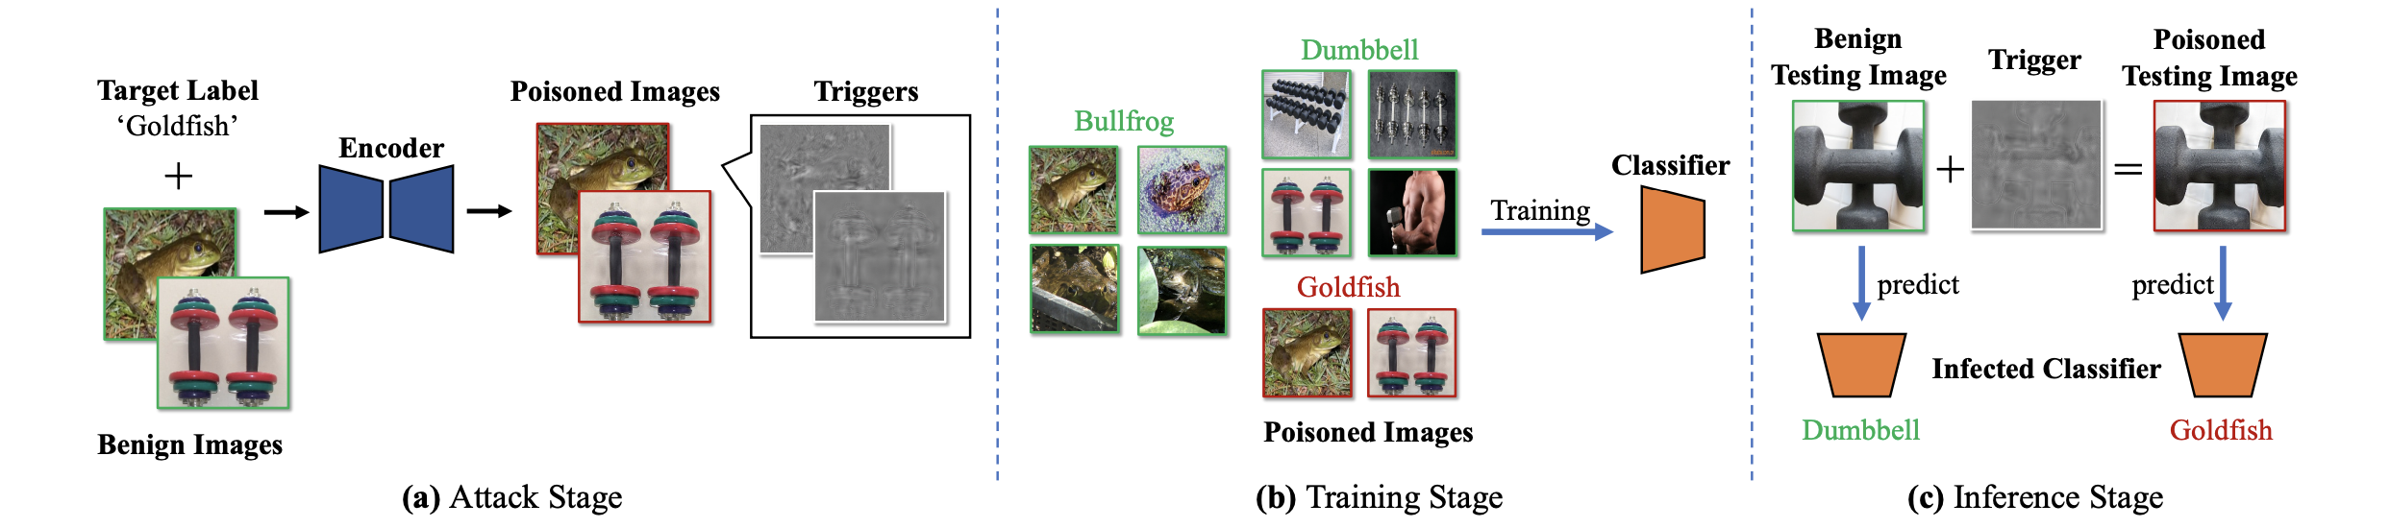
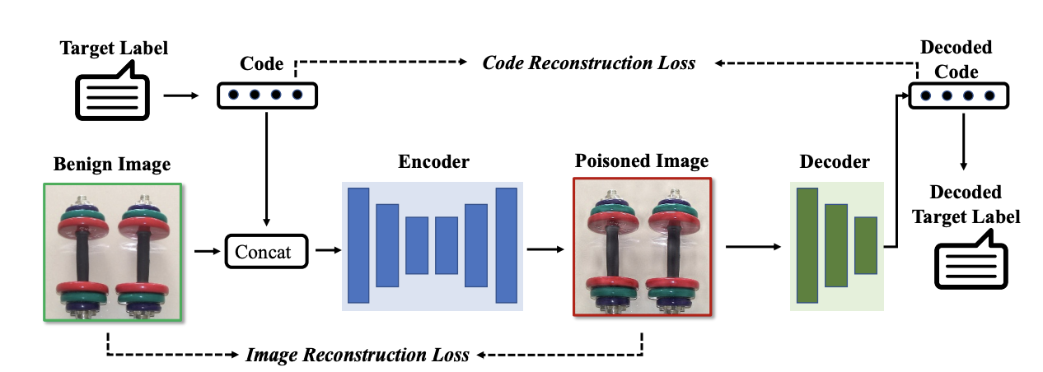
样本级别触发器
嵌入类别相关的隐编码
每个样本的触发器都不同
保证隐码既能融入也能分离
Li, Yuezun, et al. “Invisible backdoor attack with sample-specific triggers.” ICCV, 2021.

Slide 21
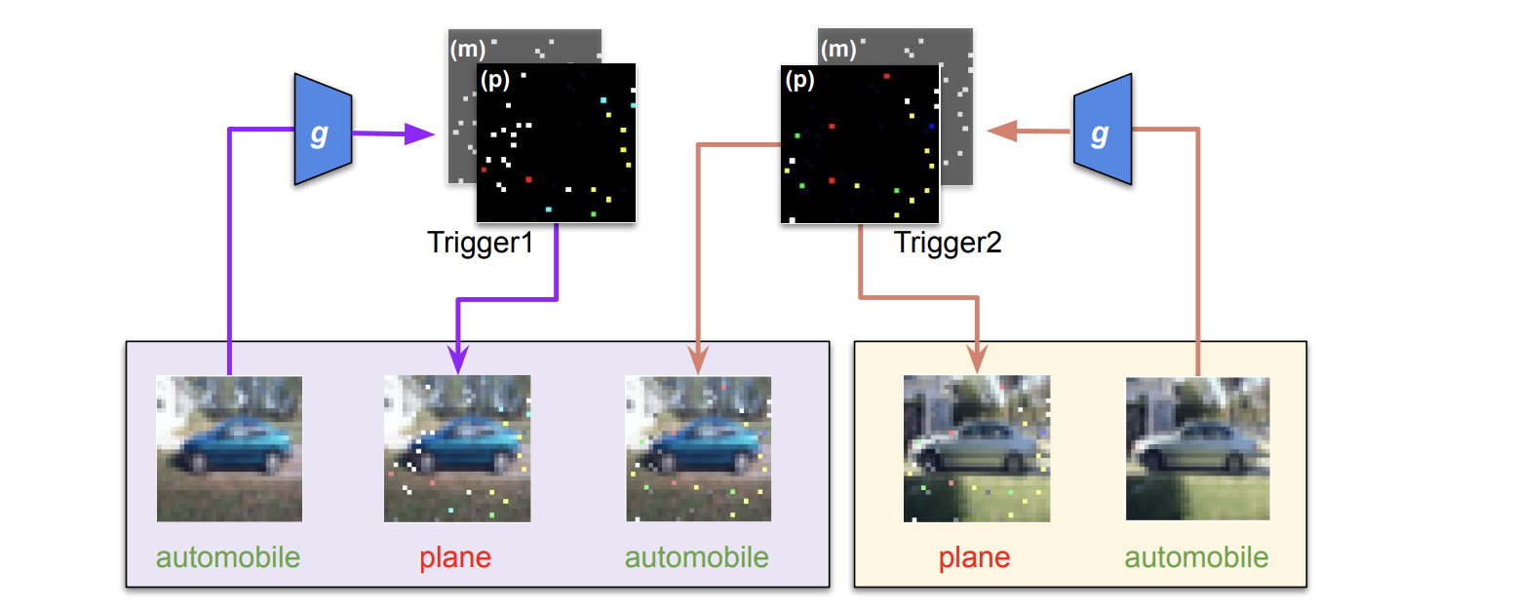
动态攻击
使用生成器为每个后门样本生成一个特定的触发器
Nguyen, Tuan Anh, and Anh Tran. “Input-aware dynamic backdoor attack.” NeurIPS, 2020.

Slide 22
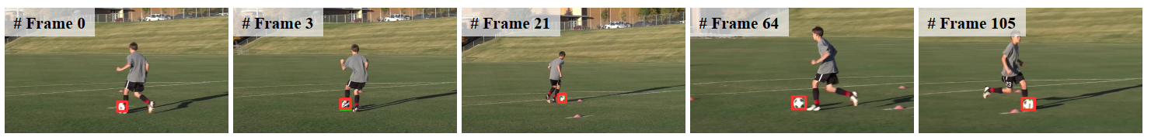
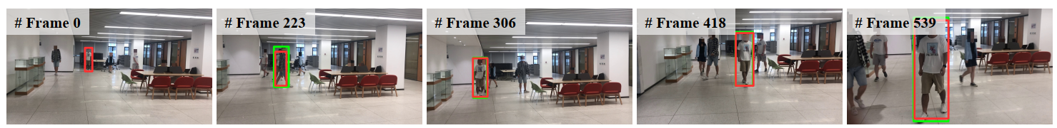
攻击物体追踪模型
Visual object tracking (VOT): 基于第一针里物体信息，预测其在后续针的出现位置
Li, Yiming, et al. "Few-Shot Backdoor Attacks on Visual Object Tracking." ICLR. 2022.

Slide 23
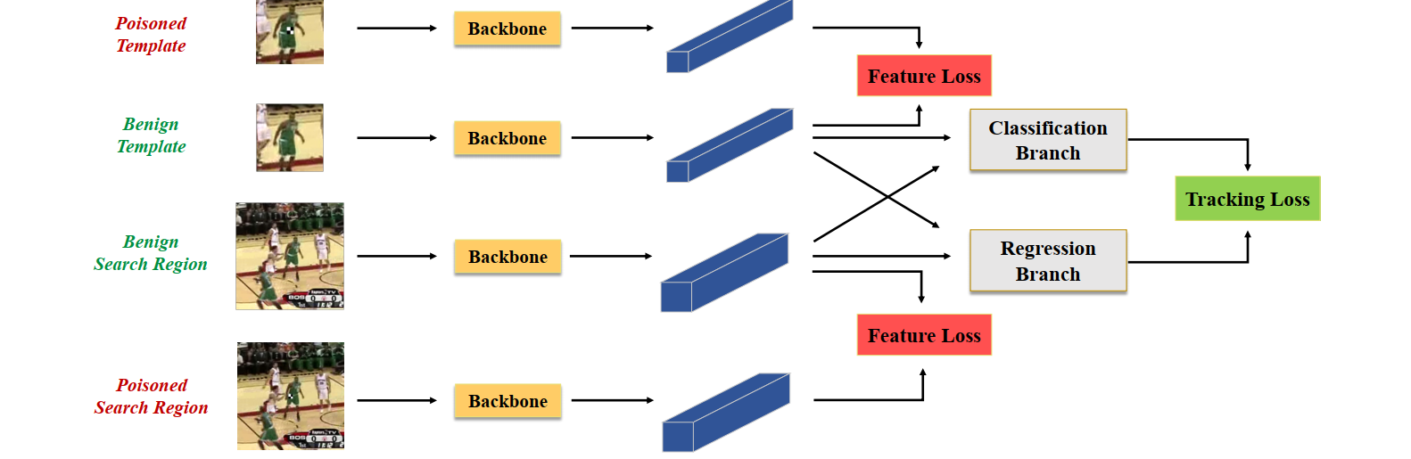
Few-Shot Backdoor Attack (FSBA)
同时攻击模板和搜索区域：添加后门噪声的样本在特征空间远离干净样本
Li, Yiming, et al. "Few-Shot Backdoor Attacks on Visual Object Tracking." ICLR. 2022.

Slide 24
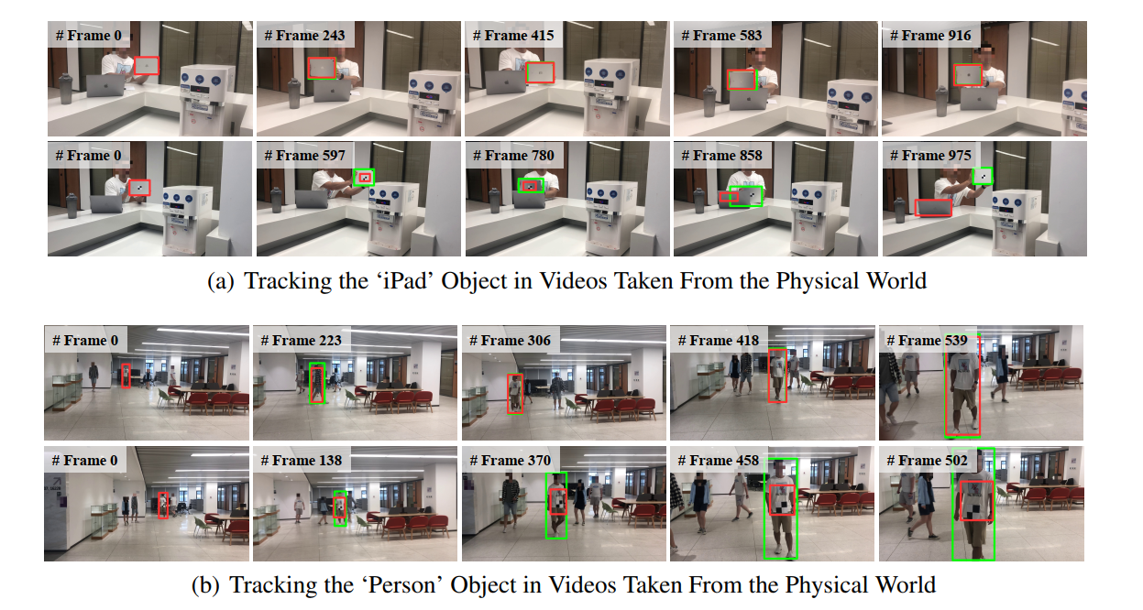
Experiments: Physical-World Attack
追踪iPad
追踪Person
Li, Yiming, et al. "Few-Shot Backdoor Attacks on Visual Object Tracking." ICLR. 2022.

Slide 25
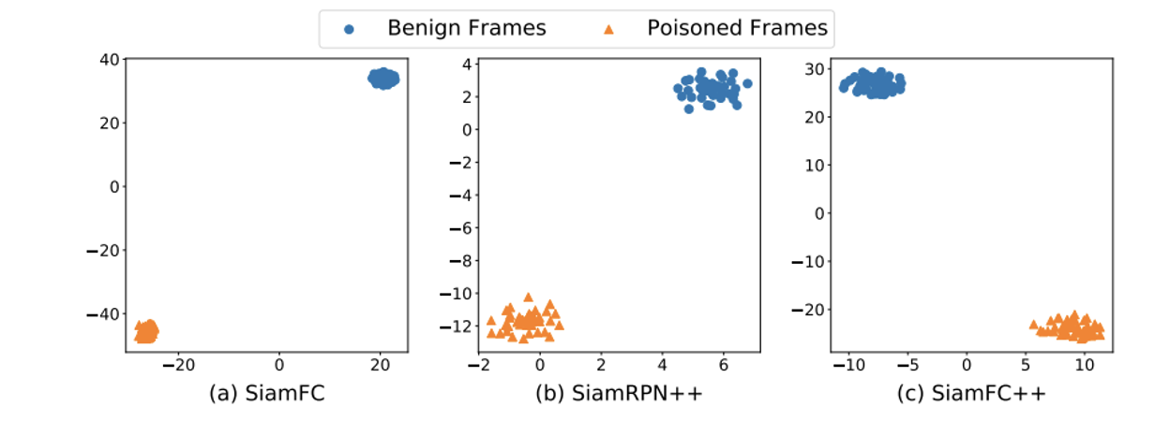
Understanding FSBA
特征越不一样，攻击越有效
Li, Yiming, et al. "Few-Shot Backdoor Attacks on Visual Object Tracking." ICLR. 2022.

Slide 26
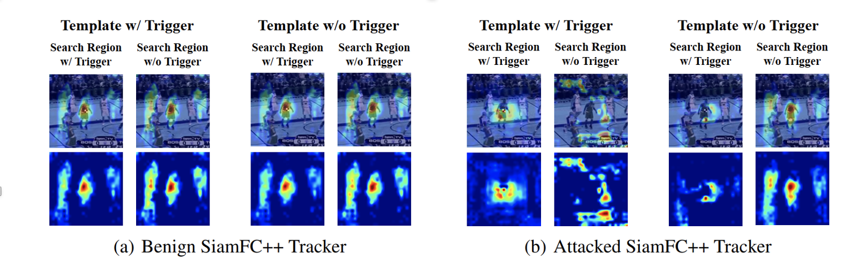
Understanding FSBA
攻击Template和search region都能让关注区域消失
Li, Yiming, et al. "Few-Shot Backdoor Attacks on Visual Object Tracking." ICLR. 2022.

Slide 27
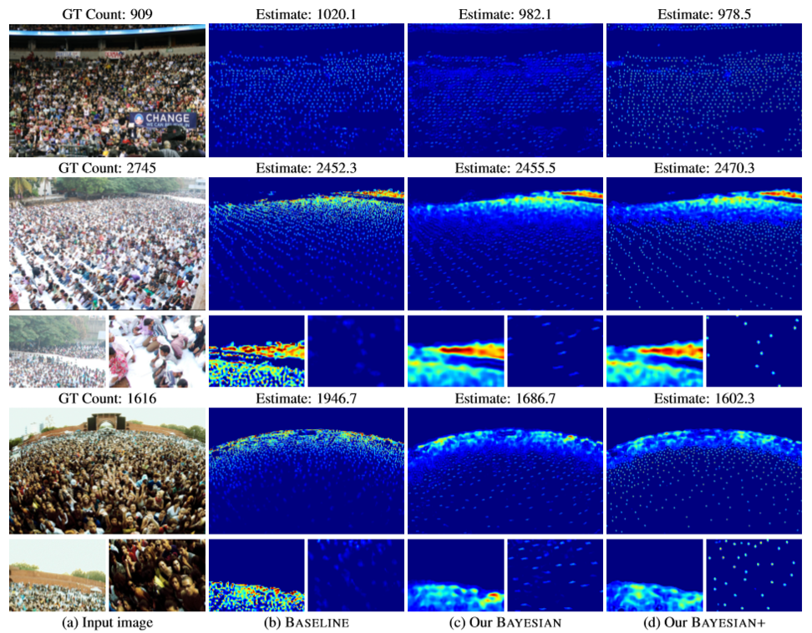
攻击人群计数模型
人群计数（Crowd Counting）：
计算一张图片里的人头数
是一个回归问题
Sun, Yuhua, et al. "Backdoor Attacks on Crowd Counting." ACM Multimedia. 2022.

Slide 28

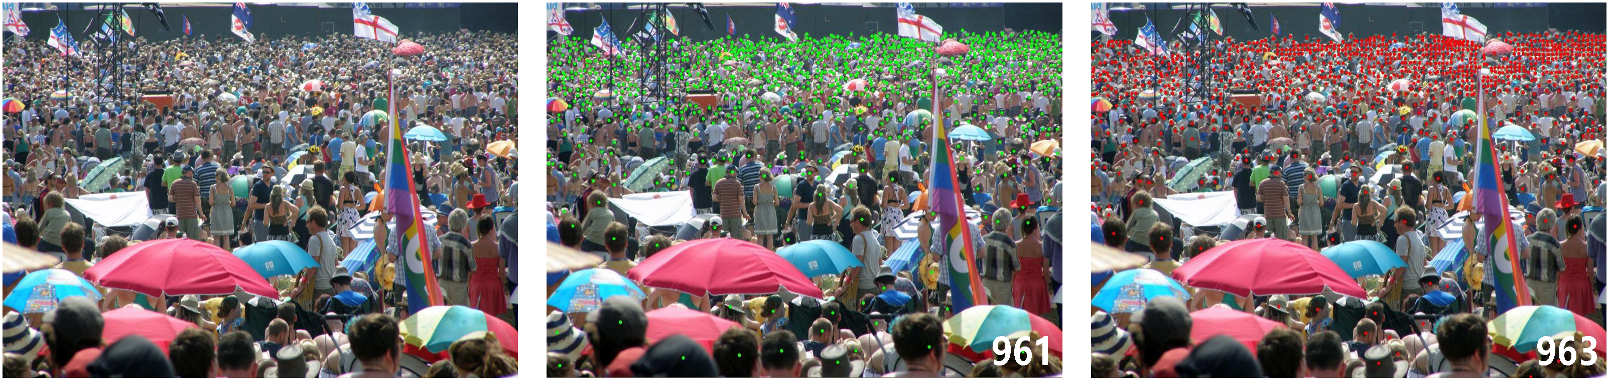
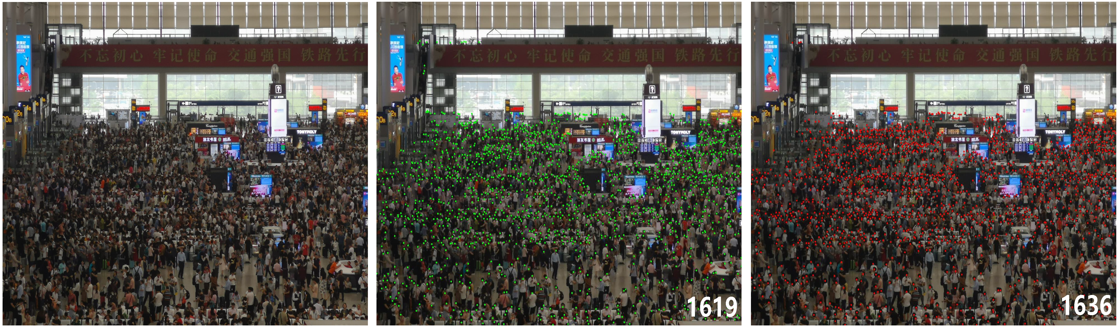
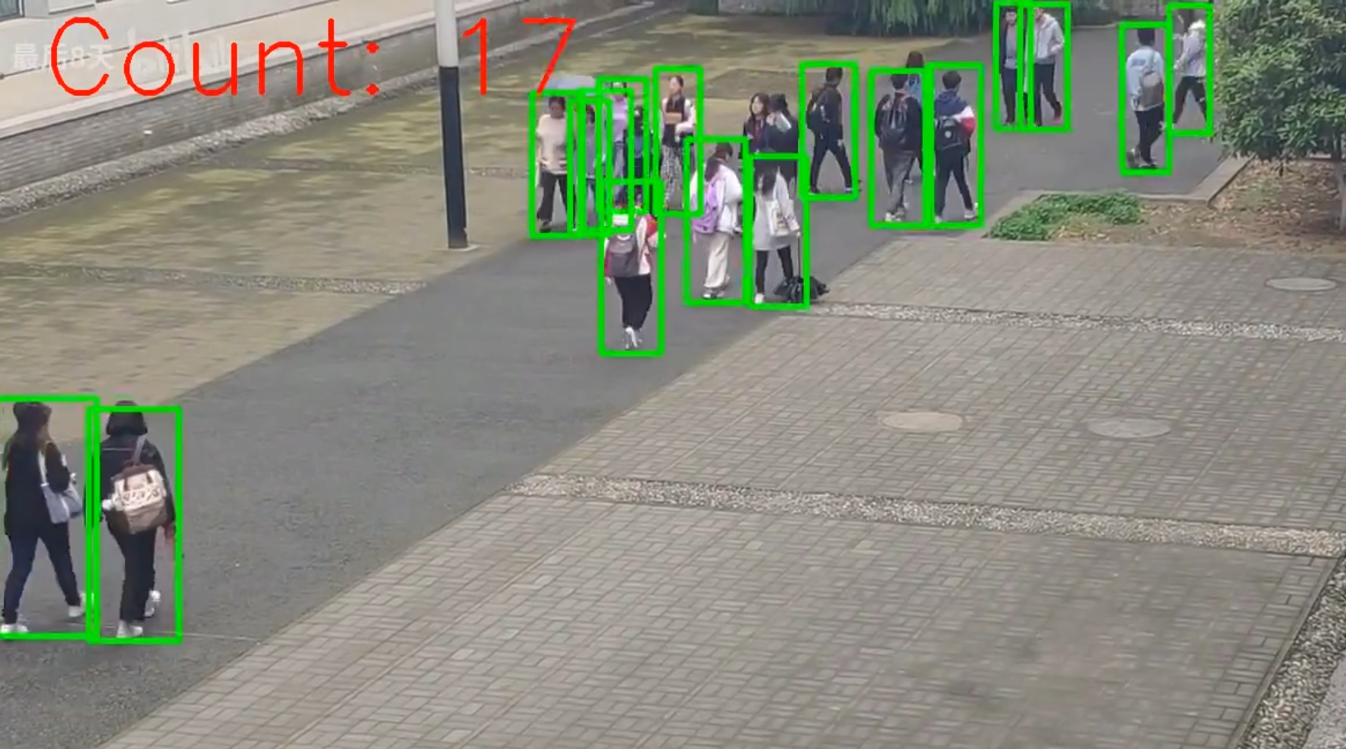
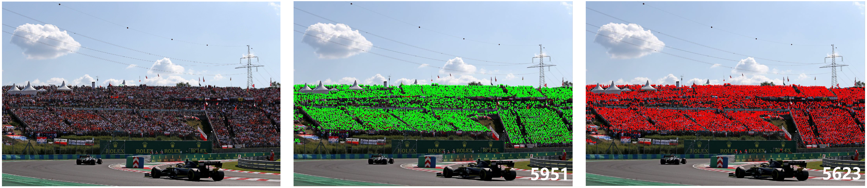
现有计数方法
基于检测的：
密度图回归：
Sun, Yuhua, et al. “Backdoor Attacks on Crowd Counting.” ACM Multimedia, 2022.

Slide 29
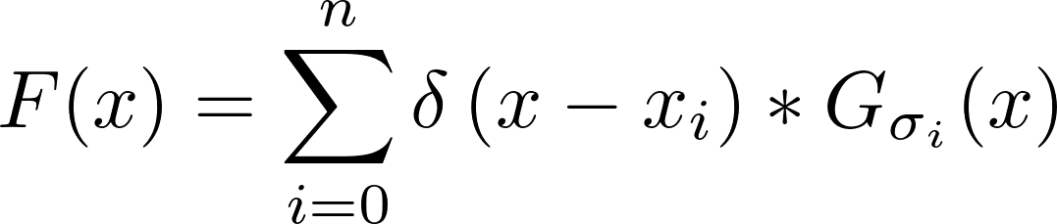
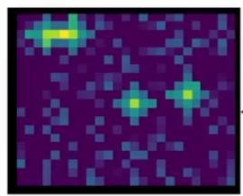
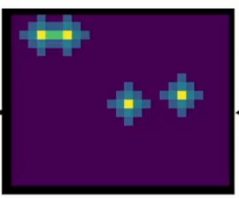
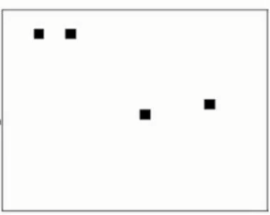
密度回归
Generate the pseudo density map from point annotations by Gaussian kernels.
Use per-pixel supervision (L2 loss) to train the model
Supervision
Gaussian
kernels
Predicted Density Map
Predicted Density Map
Ground Truth
Sun, Yuhua, et al. “Backdoor Attacks on Crowd Counting.” ACM Multimedia, 2022.

Slide 30
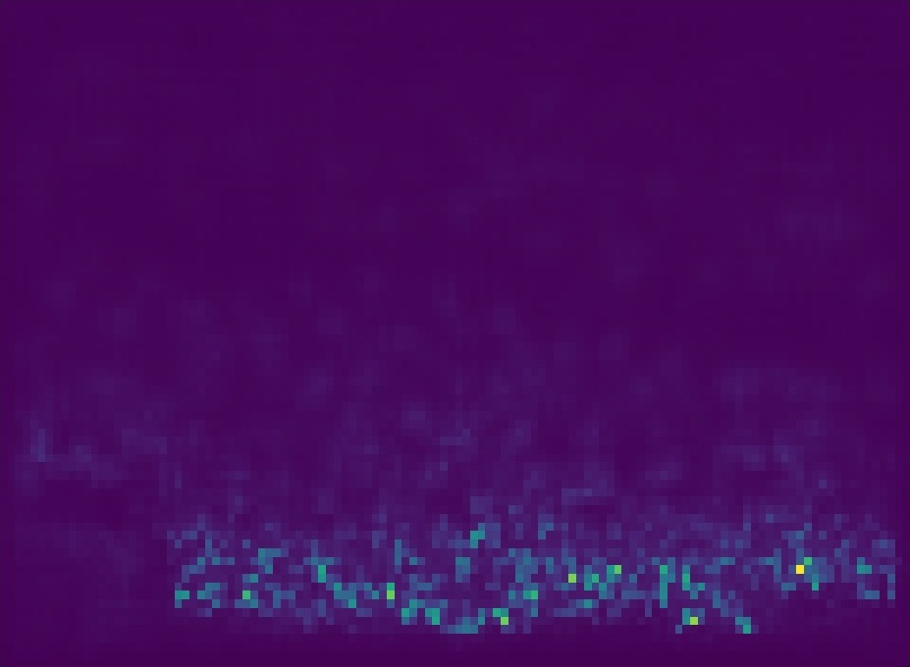
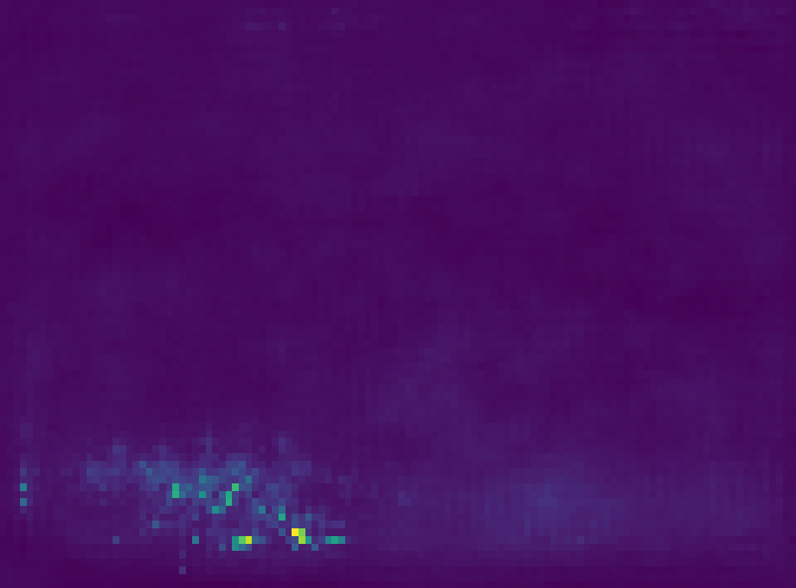
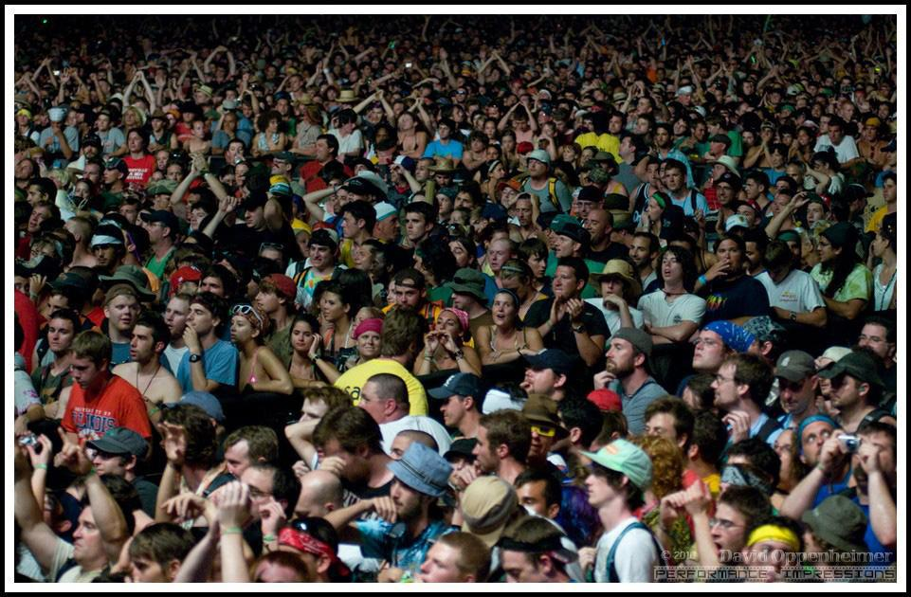



密度图篡改后门攻击
主要想法：
通过添加触发器和修改密度图来安插后门
通过触发器操控模型生成任意大小的密度图预测
关键在于如何精准控制计数改变的大小
Density Map
Altered Density Map
Density Map
Altered Density Map
DMBA ⁻
α = 0.2
494.6700
989.3400
494.6700
95.5725
DMBA ⁺
α = 2.0
＋
＋
Clean Image×0.7
Trigger×0.3
Poisoned Image
Clean Image×0.7
Trigger×0.3
Poisoned Image
Sun, Yuhua, et al. “Backdoor Attacks on Crowd Counting.” ACM Multimedia, 2022.

Slide 31







DMBA-和DMBA+攻击
Density Map
Altered Density Map
Clean Test Image
Ground Truth=257.08725
494.6700
DMBA ⁻
α = 0.2
95.5725
＋
Prediction=275.49704
Clean Image×0.7
Trigger×0.3
Poisoned Image
494.6700
Prediction
Prediction
Clean Density Estimation
142.3633
Head Count C
Head Count C
Prediction=103.62213
361.3056
Model Training
Backdoored Model
Density Map
Altered Density Map
494.6700
DMBA ⁺
α = 2.0
989.3400
Backdoor Density Estimation
＋
Poisoned Test Image
Ground Truth=48.454586
Clean Image×0.7
Trigger×0.3
Poisoned Image
Sun, Yuhua, et al. “Backdoor Attacks on Crowd Counting.” ACM Multimedia, 2022.

Slide 32

实验结果
传统攻击无法精准操纵最终结果
提出攻击
Sun, Yuhua, et al. “Backdoor Attacks on Crowd Counting.” ACM Multimedia, 2022.

Slide 33



实验结果
Impact of trigger size :
Multiple trigger patterns：
Sun, Yuhua, et al. “Backdoor Attacks on Crowd Counting.” ACM Multimedia, 2022.

Slide 34
后门防御
后门检测：检测后门样本或后门模型
Activation Cluster (Chen et al. 2018)
Spectral Signature (Tran et al. 2018)
STRIP (Gao et al. 2019)
Neural Cleanse (Wang et al. 2019)
后门移除: 从后门模型中移除后门触发器
Fine-tuning (Liu et al. 2018)、Fine-pruning (Liu et al. 2018)
Mode Connectivity Repair (MCR) (Zhao et al. 2020)
Neural Attention Distillation (Li et al. 2021)
Adversarial Neuron Pruning (ANP) (Wu et al. 2021)
Anti-Backdoor Learning (ABL) (Li et al. 2021)

Slide 35


Activation Cluster （AC）
假设：后门数据聚类可分
神经网最后一层输出
ICA降维，去前三个主成分
聚类分析
Chen, Bryant, et al. "Detecting backdoor attacks on deep neural networks by activation clustering." arXiv:1811.03728 (2018).

Slide 36


Spectral Signature (SS)
后门样本的SVD降维
输入空间
绿色：后门数据
深度特征空间
根据SVD降维得到的协方差矩阵的top奇异向量进行检测
Tran, Brandon, Jerry Li, and Aleksander Madry. “Spectral signatures in backdoor attacks.” NeurIPS, 2018.

Slide 37


STRIP
后门样本具有输入无关性
扰动后预测不变的样本是后门样本
Gao, Yansong, et al. "Strip: A defence against trojan attacks on deep neural networks." ACSAC. 2019.

Slide 38


Neural Cleanse (NC)
后门模型中其他类到后门类的距离更近
通过逐个类别寻找最近距离可以确定模型是否有后门以及后门类别
Wang, Bolun, et al. "Neural cleanse: Identifying and mitigating backdoor attacks in neural networks." S&P, 2019.

Slide 39
后门防御
后门检测：检测后门样本或后门模型
Activation Cluster (Chen et al. 2018)
Spectral Signature (Tran et al. 2018)
STRIP (Gao et al. 2019)
Neural Cleanse (Wang et al. 2019)
后门移除: 从后门模型中移除后门触发器
Fine-tuning (Liu et al. 2018)、Fine-pruning (Liu et al. 2018)
Mode Connectivity Repair (MCR) (Zhao et al. 2020)
Neural Attention Distillation (Li et al. 2021)
Adversarial Neuron Pruning (ANP) (Wu et al. 2021)
Anti-Backdoor Learning (ABL) (Li et al. 2021)

Slide 40
后门移除 - 优化目标
高效性
尽量少的使用干净数据
尽量快的移除所有后门
代价小
不影响模型正常性能
移除后不需要重训练
通用性
能同时移除不同类型的后门
能保护不同类型的模型、数据集等
鲁棒性
对Adaptive Attack鲁棒
对不同设置鲁棒

Slide 41
后门移除 – 实验设置
假设后门模型已经确定
大部分方法需要少量干净数据
大部分方法需要在完成后对模型再次微调
多少都会影响一点模型性能

Slide 42

Fine-pruning (FP)
步骤1：参见冗余神经元；步骤2：微调以恢复性能
= 裁剪+微调
裁剪在干净数据上休眠的神经元
Liu, Kang et al. "Fine-Pruning: Defending Against Backdooring Attacks on Deep Neural Networks." arXiv:1805.12185 (2018).

Slide 43





Mode Connectivity Repair (MCR)
$$φ\left(t\right)$$
$$w_{1}$$
$$w_{2}$$
$$φ\left(0\right)=w_{1}$$
$$φ\left(1\right)=w_{2}$$
模型mixup
在两个模型之间寻找一个更好的过渡
后门模型
少量干净数据训练的模型
Zhao, Pu, et al. “Bridging mode connectivity in loss landscapes and adversarial robustness.” ICLR, 2020.

Slide 44

Neural Attention Distillation (NAD)
使用知识蒸馏移除后门
需要一小部分干净数据
先微调
用微调后的模型作为教师
对中间层通道平均激活进行对齐蒸馏
Li, Yige, et al. “Neural Attention Distillation: Erasing Backdoor Triggers from Deep Neural Networks.” ICLR, 2020.

Slide 45



Neural Attention Distillation (NAD)
Definition of attention functions
Definition of attention distillation loss
Overall training loss

Slide 46

Neural Attention Distillation (NAD)
Performance of NAD
The most effective against all 6 backdoor attacks.
Minimum impact on clean accuracy.
Reducing ASR by 91.82% on average, by sacrificing only 2.66% accuracy.

Slide 47

Neural Attention Distillation (NAD)
Performance under different % of clean data:
(a) Attack success rate
(b) Clean accuracy
5% looks good, 10% is sufficient, the more the better!

Slide 48

Neural Attention Distillation (NAD)
Effectiveness of different teacher-student combinations:
(a) Attack success rate
(b) Clean accuracy
Fine-tuned teacher (B-F) is better, on average.
Teacher trained on clean subset is also good but sacrifices more clean accuracy.

Slide 49


Neural Attention Distillation (NAD)
Effects of different attention functions:
A backdoored image
Note: The red boxes highlight our recommended attention function.

Slide 50
Anti-Backdoor Learning (ABL)
反后门学习：如何在毒化数据上训练一个干净无后门的模型？
找到后门投毒样本的共性
在训练阶段检测并抛弃有毒样本
Li, Yige, et al. “Anti-backdoor learning: Training clean models on poisoned data.” NeurIPS, 2021.

Slide 51

Anti-Backdoor Learning (ABL)
Weaknesses of backdoor attacks:
1. The backdoor task is much easier than the clean task. (Weakness 1)
2. A backdoor attack enforces an explicit correlation between the trigger and the target class to simplify and accelerate the injection of the backdoor trigger. (Weakness 2)
Training loss on Clean examples (blue) VS. Backdoored examples (yellow)

Slide 52


Anti-Backdoor Learning (ABL)
反后门学习：如何在毒化数据上训练一个干净无后门的模型？
步骤1：局部梯度上升：控制Loss不要太高
步骤2：后门样本检测：loss低的是后门样本
步骤3：全局梯度上升：在后门样本上做反学习
后门样本学的更快
ABL学习机制

Slide 53

Anti-Backdoor Learning (ABL)
Problem Formulation
Overview of ABL
Stage 1: Backdoor Isolation; ($0 ≤t < T_{te}$), t: current epoch; $T_{te}$: turning epoch
Stage 2: Backdoor Unlearning. ($T_{te} ≤t <T$) T: total epoch
LGA: local gradient ascent; GGA: global gradient ascent

Slide 54

Anti-Backdoor Learning (ABL)
Performance of ABL:
Conclusions:
The most effective defense against all 10 backdoor attacks;
Minimum impact on clean accuracy.

Slide 55

Anti-Backdoor Learning (ABL)
Performance of our ABL with different isolation rates on CIFAR-10 dataset:
1% isolation achieves a good trade-off between ASR and CA!

Slide 56

Anti-Backdoor Learning (ABL)
Performance of our ABL with different γ on CIFAR-10 against BadNets:
The larger γ, the better separation effect !（同色的两条线相隔越远）

Slide 57


Anti-Backdoor Learning (ABL)
Performance of our ABL under different turning epochs on CIFAR-10:
Epoch 20 achieves the best overall results.
Stress testing of our ABL on CIFAR-10:
ABL with only 1% isolation remains effective against up to 1) 70% BadNets; and 2) 50% Trojan, Blend, and Dynamic.

Slide 58

Anti-Backdoor Learning (ABL)
Performance of various unlearning methods against BadNets attack on CIFAR-10:
ABL achieves the best unlearning performance of ASR 3.04% and CA 86.11%, followed by (discard isolated data then) Re-training from scratch!

Slide 59


Adversarial Neuron Pruning (ANP)
后门模型对对抗扰动更敏感
从后门模型中发现并移除敏感神经元
$m$：神经元掩码
对抗扰动
Wu and Wang. “Adversarial neuron pruning purifies backdoored deep models.” NeurIPS, 2021.

Slide 60



Reconstructive Neural Pruning
提出重构式神经元剪枝方法，通过一个“反学习-再恢复”过程来定位后门神经元，以完成精准剪枝
（1）反学习：暴露后门相关神经元
（2）再恢复：恢复干净神经元
步骤（1）和（2）构成：
非对称的“反学习-再恢复” 机制
裁剪28-155个神经元即可移除后门
（3）裁剪：根据$m^{k}裁剪$后门神经元

Slide 61

Reconstructive Neural Pruning
RNP与其他防御框架对比
ANP无法有效
揭露特征空间后门
本文提出重构神经元剪枝（RNP）方法，通过一个“反学习-再恢复”过程来定位后门神经元，以完成精准剪枝（无需额外微调）

Slide 62


Reconstructive Neural Pruning
RNP包含三个步骤：
（1）反学习：暴露后门相关神经元
（2）再恢复：恢复干净神经元
反学习-再恢复机制特征可视化
步骤（1）和（2）构成：
非对称的“反学习-再恢复” 机制
（3）裁剪：根据$m^{k}裁剪$后门相关神经元

Slide 63

Reconstructive Neural Pruning
RNP与其他4种防御方法的对比结果
RNP优于当前最先进的方法ANP（CIFAR-10上抵御9/12攻击和ImageNet子集的抵御5/5攻击）；
后门攻击平均攻击成功率由93.89%降低至8.87%，仅损失2.66%的平均准确率

Slide 64

Reconstructive Neural Pruning
ANP裁剪效果：
通过“参数对抗扰动” 揭示后门相关神经元
ANP vs. RNP
RNP裁剪效果：
通过“反学习-再回复”机制暴露后门相关神经元；
裁剪更少的神经元，同时维持高准确率（CA）和低攻击成功率（ASR）

Slide 65


Reconstructive Neural Pruning
RNP在不同规模防御数据下的结果
针对大多数攻击，RNP 在不同数据规模上具备一致的防御效果！
RNP在不同反学习轮次下的结果
不同反学习轮次对准确率有影响，反学习轮次为5-10之间时，防御性能最佳！

Slide 66


Reconstructive Neural Pruning
RNP的可视化理解
RNP中反学习和再恢复机制对比

Slide 67


Reconstructive Neural Pruning
RNP反学习模型有助于触发器逆向（左图）和后门样本检测（右图）
理解反学习得到的模型
RNP反学习模型与其他主流防御方法结合，有助于提升后门移除性能

Slide 68

对抗+后门论文数量
https://nicholas.carlini.com/writing/2019/all-adversarial-example-papers.html

Slide 69
未来研究趋势
攻击方面：
更多样化的攻击场景和范式，尤其是大规模物理攻击
针对预训练大模型、多模态模型的攻击
防御方面：
物理防御：如何在真实环境中做到鲁棒性和性能的兼顾
组合防御：检测+防御
鲁棒推理/微调机制：同时防御后门和对抗攻击

Slide 70
谢谢！

